Slide 1


Slide 2


Slide 3
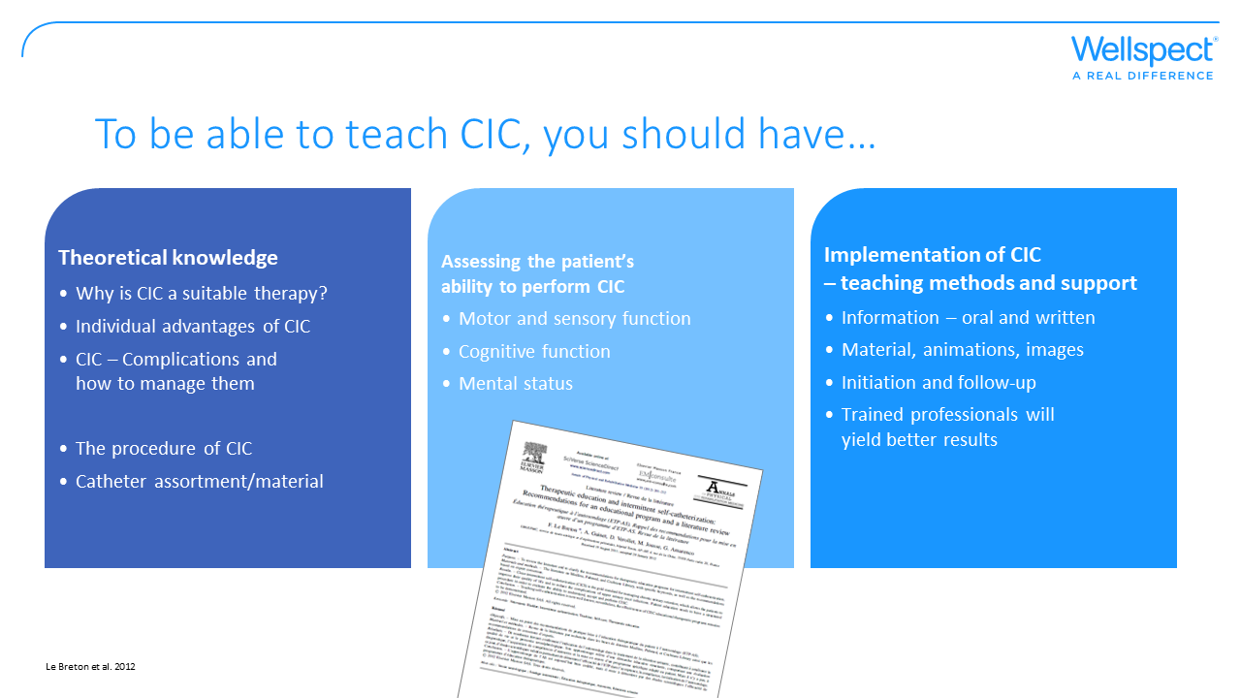
Notes:
Recommendations for a teaching program and a literary overview by Le Breton

Slide 4
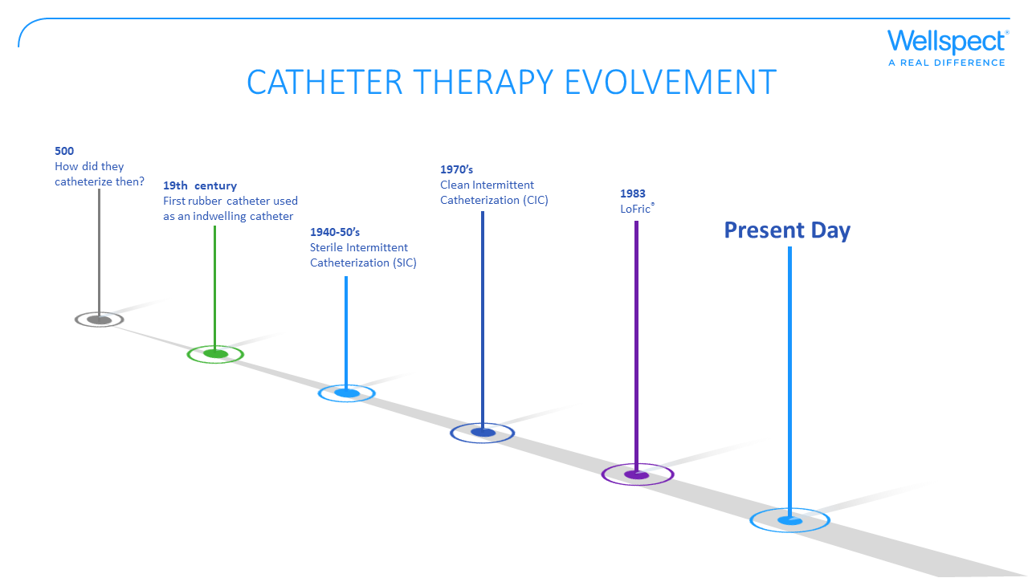

Slide 5
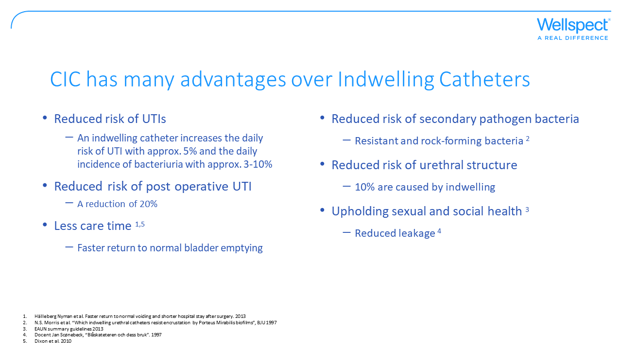
Notes:
An indwelling catheter is an invasive procedure, either through the abdominal wall (suprapubic) or urethral and has a continuous emptying. Catheter associated UTIs is the most common complication with all catheterization. CIC is reported to reduce the risk of infection compared to indwelling catheters – for example a 20% reduction after short post operative use. CIC enables quicker return to normal bladder emptying, which reduces hospital stay after surgery.
Biofilm surrounding CAD (Catheter a demure): Patients with CAD are often subjected to bacteriuria, despite good care. Bacteria attach to catheter surfaces, forming a biofilm, which means that treatment becomes more difficult since the antibiotics cannot penetrate this biofilm. Some bacteria, usually Protesu Mirabilis, have an enzyme called ureas that can decompose urea into ammoniac, raising the pH of the urine. Magnesium- and calciumphosfate crystals can form on catheter surfaces and in the urine, eventually forming urinary tract concrements, which make treating urinary infections more difficult. Almost 10% of strictures are caused by CADs, because of the S-shape of men’s urethra. Leakage is often a consequence of bladder irritation caused by the catheter which can cause powerful bladder contractions.

Slide 6
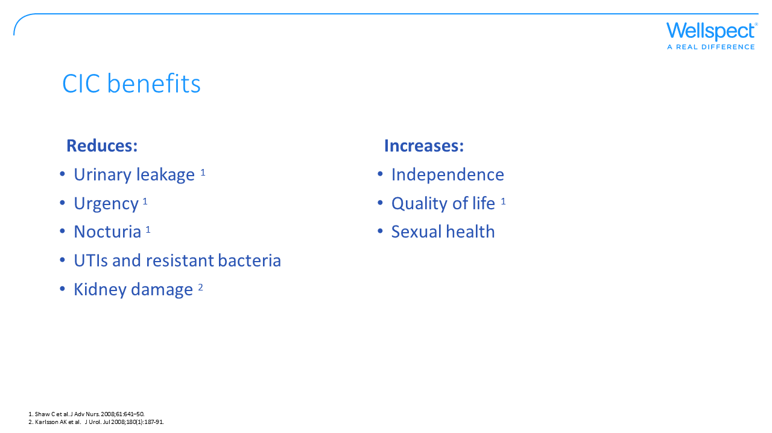
Notes:
CIC is very close to normal bladder emptying, preserving renal function. It also has positive effects on the lower urinary tract, easing symptoms in that area and improving quality of life. CIC enables a sexual relation without leakage or discomfort.

Slide 7
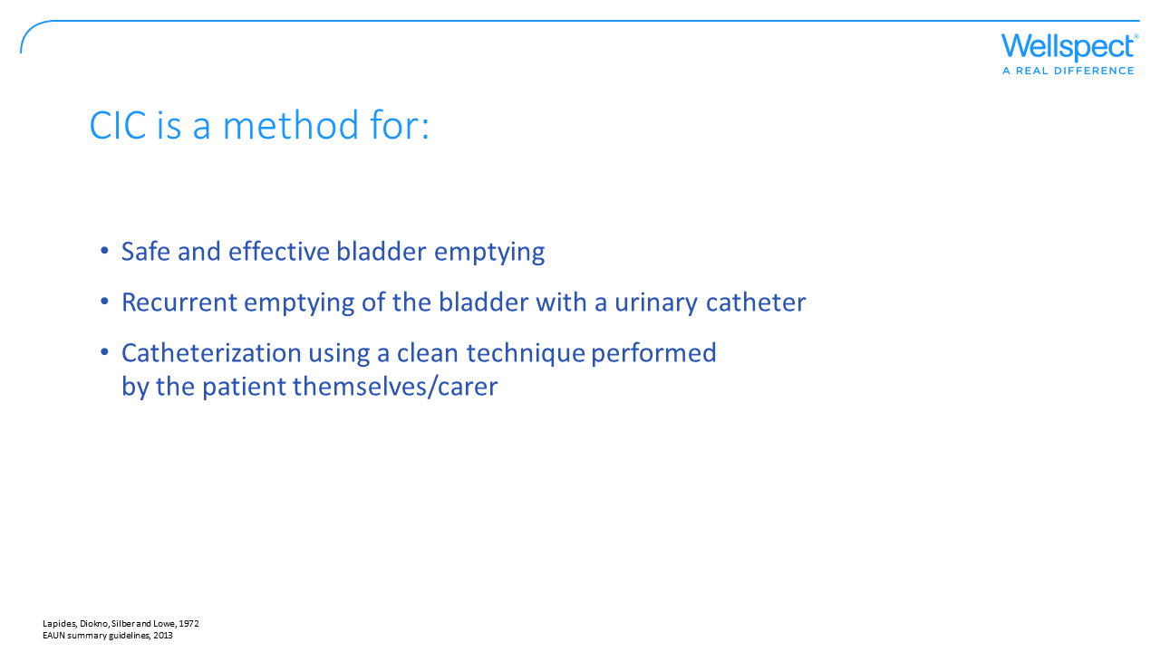
Notes:
CIC is a safe and effective method which means regularly emptying the bladder with a single use urinary catheter, either by yourself or someone else helping you. Dr Jack Lapides established during the 1970’s that it is more important to empty the bladder regularly than carrying out the procedure in a sterile fashion. He introduced the term CIC, which is now considered golden standard when handling urinary retention. Always considering CIC as a firsthand choice before considering using a CAD is backed by studies and scientific proof.

Slide 8
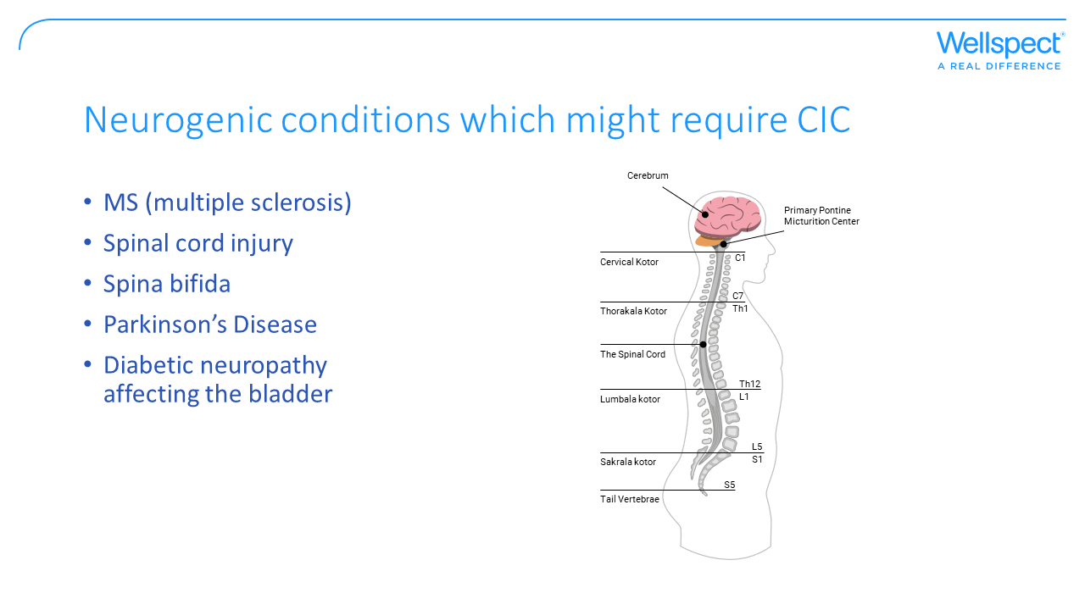
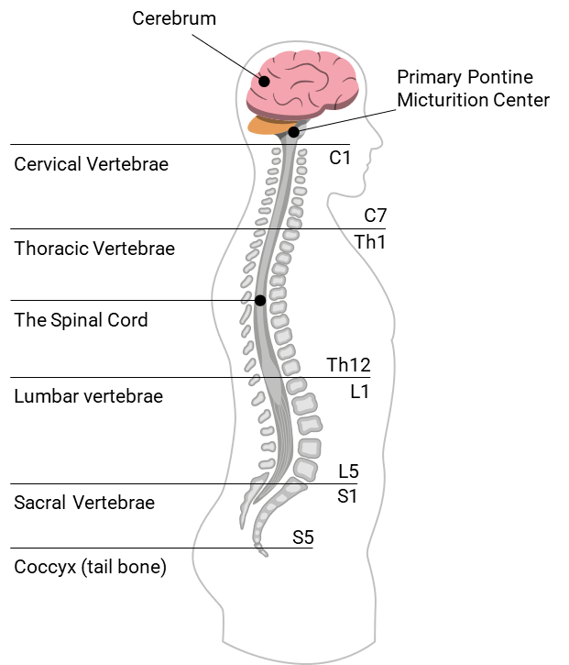
Notes:
The spinal cord and the brain play an important role for urinary problems in neurogenic diseases. When the nerves are damaged, it becomes harder for the signals between the brain and the part of the spinal cord controlling the urinary organs to reach their destination. This can cause leakage and the bladder not being fully emptied when peeing as the sphincter in the urethra is not opened when the bladder contracts (detrusor-sphincter dyssynergia) to empty the urine. If the damage is within or below S2-S4 the detrusor muscle is usually too weak to expel the urine.
In MS, inadequate transfer of nerve impulses may lead to residual urine
In an injury or disease affecting the spinal cord, the symptoms vary depending on whether the damage is below or above S2-S4 and whether is a complete or in complete damage
In Parkinson’s Disease the most common symptom is detrusor overactivity, with or without residual urine
In diabetic neuropathy affecting the bladder, peripheral nerve damage may reduce awareness of bladder filling and also impair the ability to empty the bladder.

Slide 9
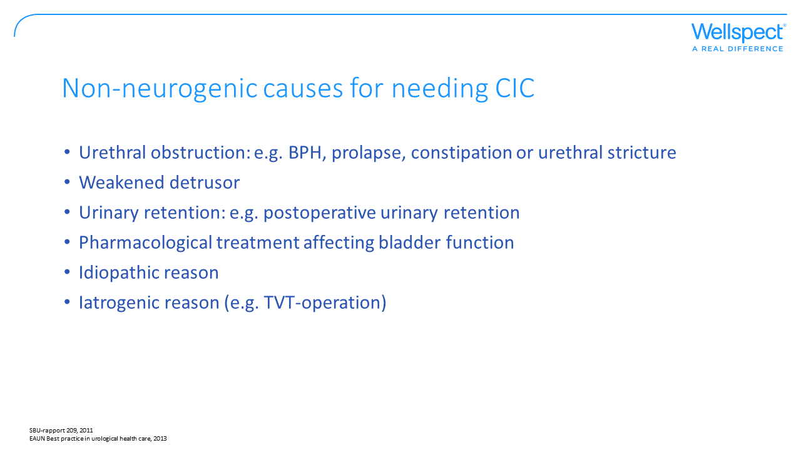
Notes:
The most common reason for obstruction in adult men is BPH, which can lead to urinary retention or residual urine. A weakened detrusor muscle or atonic bladder occurs in mechanical impact on the bladder muscles and peripheral innervation through extension. You might have a hard time detecting when it’s time to empty your bladder and also lack the power in the bladder to expel the urine. When being treated with pharmaceuticals, e.g. Botox for overactive bladder, catheterization might be the best alternative to ensure complete bladder emptying. Other pharmaceuticals, such as anti-cholinergics and anti-psychotic drugs might result in detrusor weakness. Also, constipation might complicate bladder emptying since the bowel presses against the bladder.

Slide 10
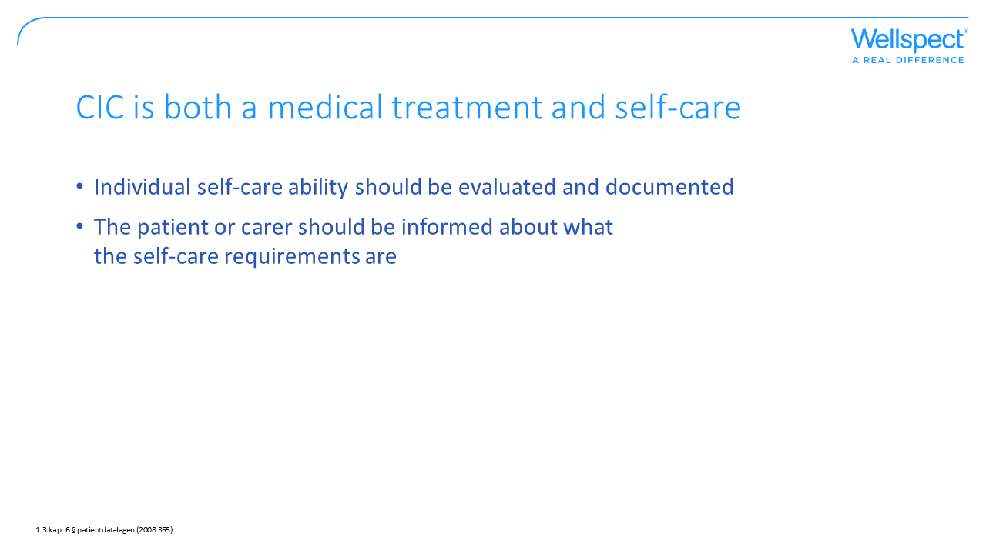
Notes:
The healthcare should document the evaluation and analysis of self-care in the patient journal. It’s important that the one making the evaluation gives an account for his/her position. The extent of the documentation varies from case to case and the complexity of the evaluation. A patient journal should contain the information needed for good and safe care of the patient and the necessary information regarding measures taken.

Slide 11
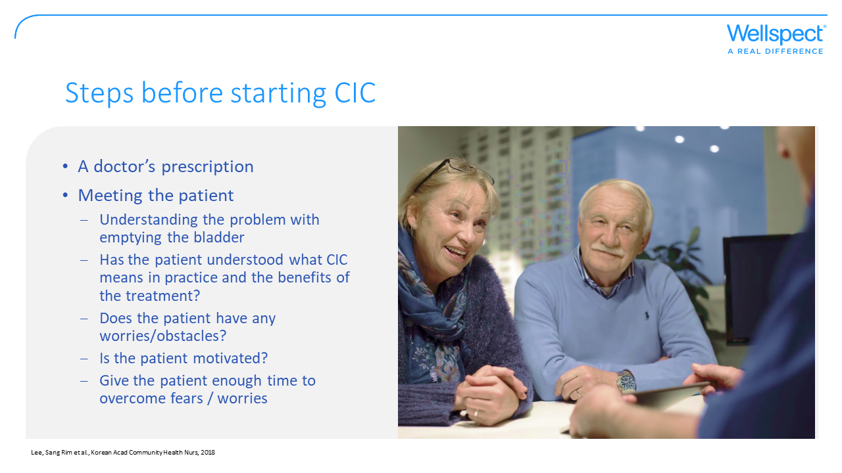

Slide 12
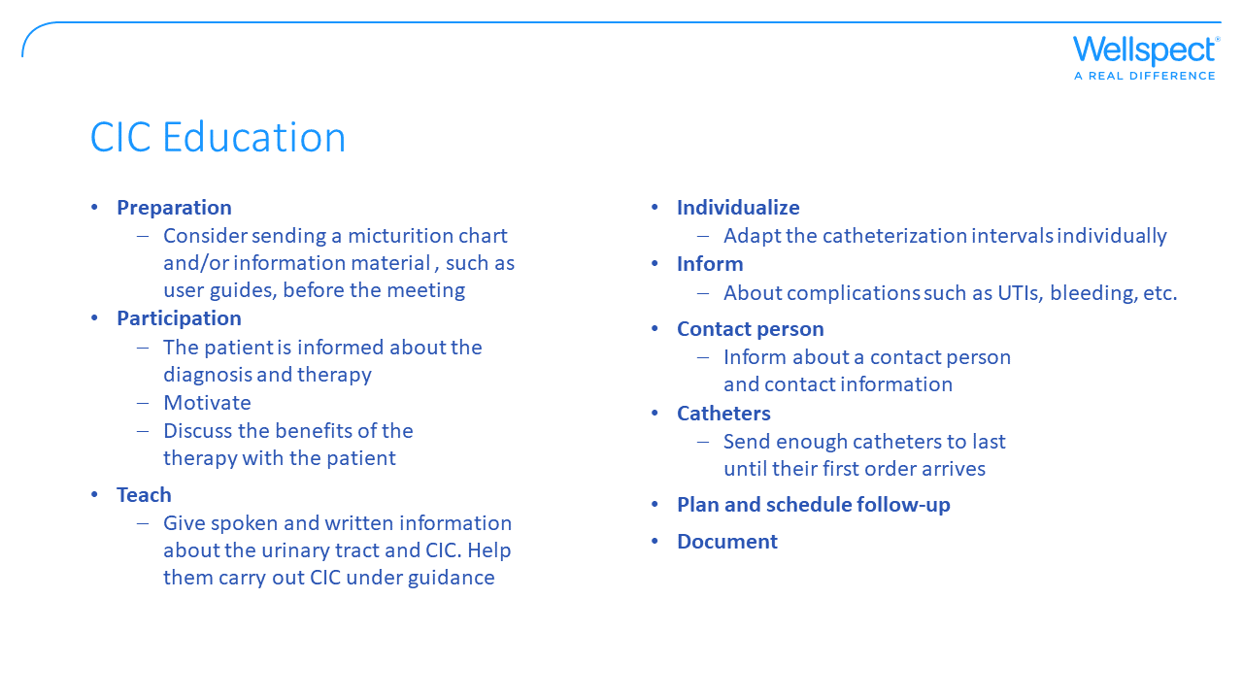
Notes:
It is pivotal that the patient is given a good knowledge of the anatomy and physiology of the urinary tract as well as a good understanding of the benefit of their treatment. Using pictures and illustrations to visualize often helps. A user guide can be a good way for the patient to learn more about the therapy before or after the visit.
Complications: inform the patient of the difference between asymptomatic bacteriuria (ABU) and symptomatic urinary tract infection, with its characteristic symptoms such as urgency, fever, pain and hematuria. Many CIC-users have ABU, but normally that does no need treatment.
Please do a careful walkthrough with the patient about how to handle the catheters and the other material. In order to ensure good compliance over time, a structured and pedagogical education and follow-up of the therapy is required. Plan for the first visit to last for about 60 mins.

Slide 13
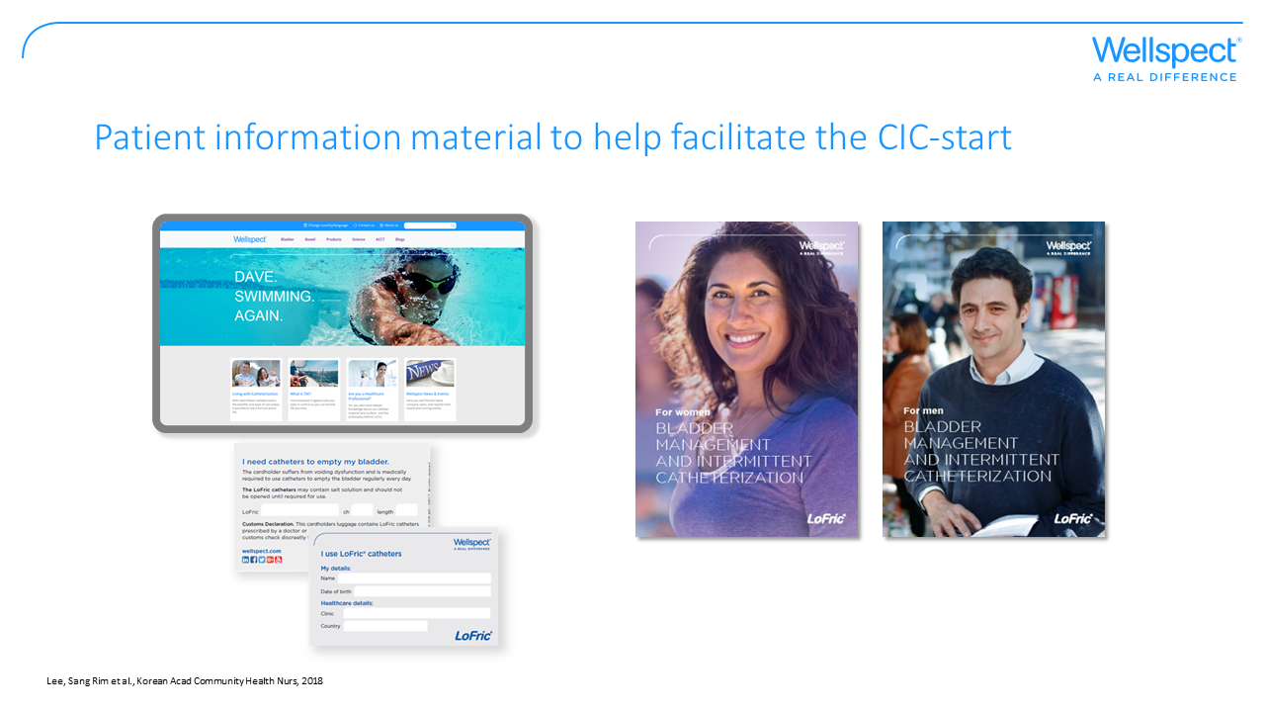
Notes:
Just as the studies show, it’s very important to give the patients good information before they begin using CIC, and it’s also important with a good follow-up.
Wellspect offers a wide assortment of information material in order to help the patient to a good start:
User guides for men, women, SCI-patients, BPH, MS and Parkinson’s – these are also available as e-books
Please fill in and give out the id-card that helps the user when in contact with the healthcare. It’s also useful when travelling.
At Wellspect.com you’ll find material and information such as:
Product information
E-books
Instruction films
Testimonials and much more…

Slide 14
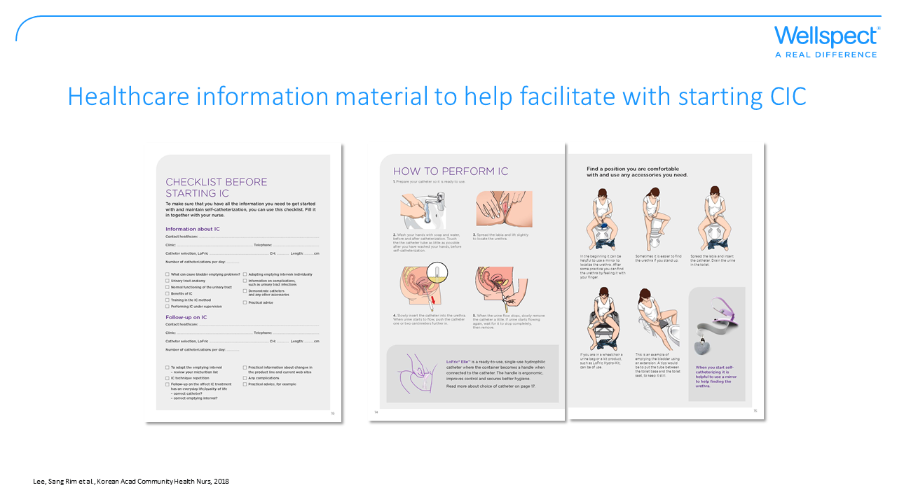
Notes:
Just as the studies show, it’s very important to give the patients good information before they begin using CIC, and to do a thorough follow-up
There is material helping you when teaching CIC in our office, such as:
Flip over: For men and women containing material to help you as a prescriber explaining the CIC-therapy, anatomy pictures and other information that’s useful to go through with the patient before starting CIC.
Checklist: As support when teaching CIC.
This material may be ordered through Wellspect – either through your sales representative or through our website.

Slide 15
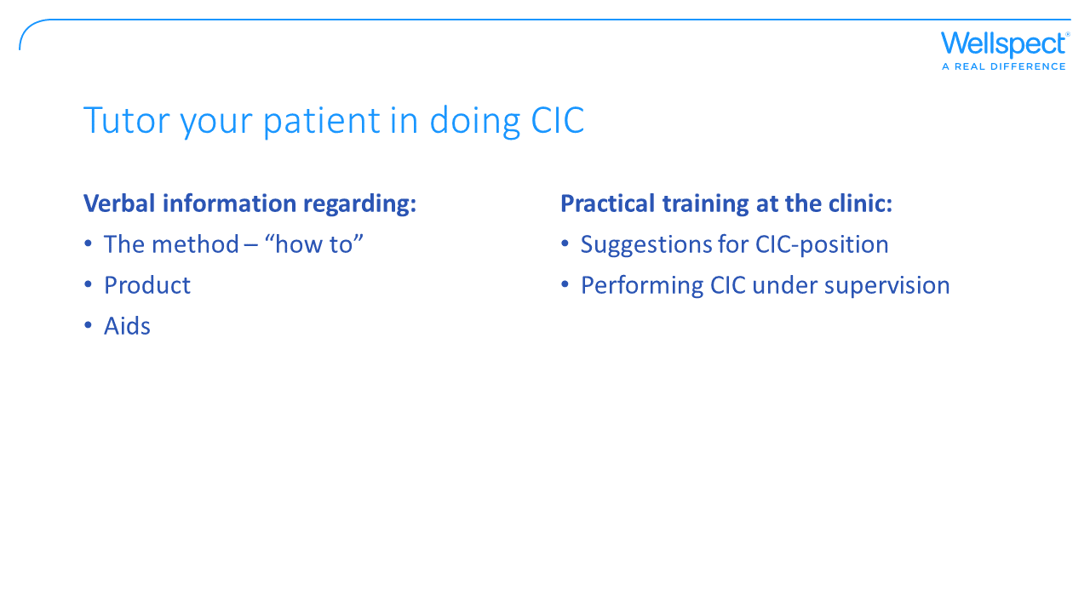

Slide 16
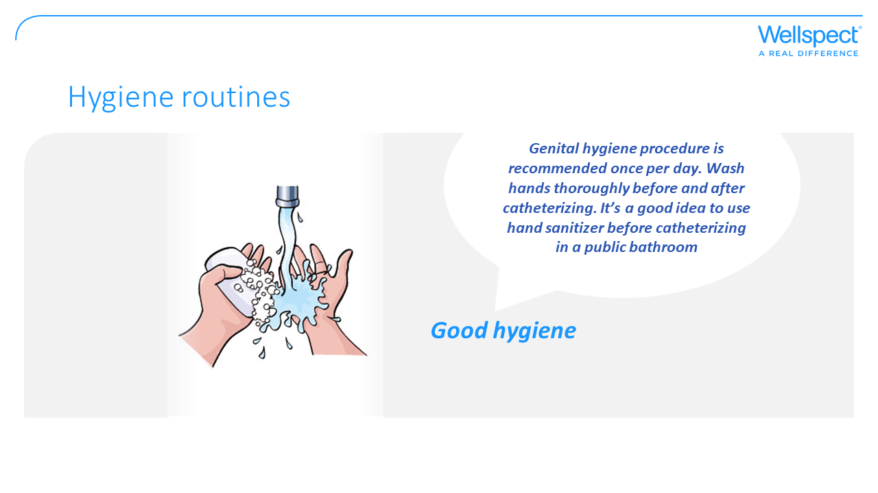
Notes:
Genital hygiene procedure is recommended once per day. Wash hands thoroughly before and after catheterizing
It’s a good idea to use hand sanitizer before catheterizing in a public rest room

Slide 17
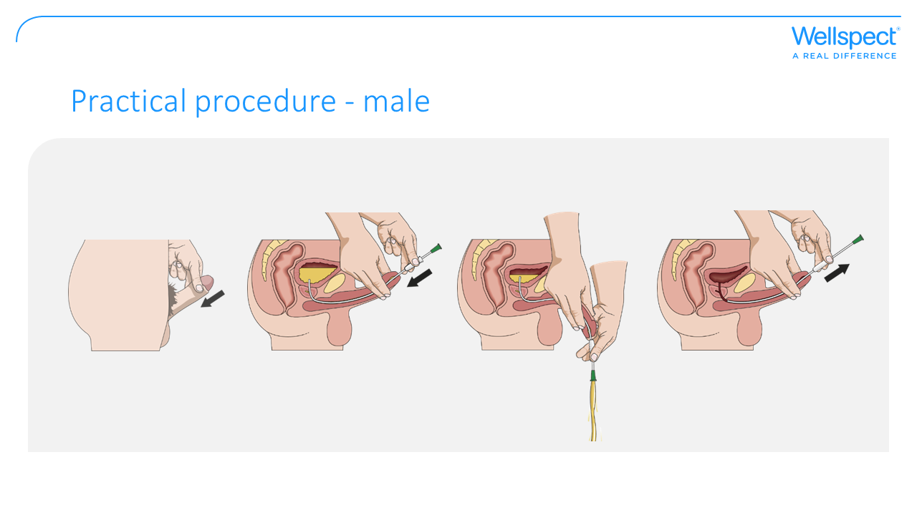
Notes:
Find a position that fits the patient – standing or sitting down
It’s important to hold penis upwards towards the stomach when the catheter is inserted in order to straighten the angle of the urethra
Slowly insert the catheter into the urethra
When the urine starts to flow, then insert the catheter another couple of centimeters. Hold the penis in its normal position when urine starts flowing through the catheter
When urine stops flowing, slowly withdraw the catheter, pause if more urine comes through the catheter. When you know that the bladder is empty, fold the catheter or place a finger over the connector before the catheter is removed, creating a vacuum that ensures the last drops remain inside the catheter

Slide 18
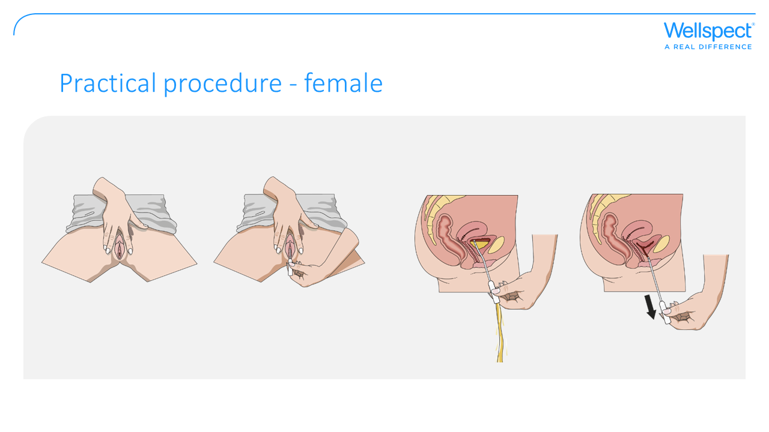
Notes:
Find a suitable position
Push the pelvis forward, spread the labia, lift a little bit upwards with one hand to find the urethra. At the beginning it can be a good idea to use a mirror to find the urethra. After some practice, women are usually able to locate the urethral opening with their fingers without having to use a mirror.
Slowly insert the catheter into the urethra
When the urine starts to flow, then insert the catheter another couple of centimeters. Hold the penis in its normal position when urine starts flowing through the catheter
When urine stops flowing, slowly withdraw the catheter, pause if more urine comes through the catheter. When you know that the bladder is empty, fold the catheter or place a finger over the connector before the catheter is removed, creating a vacuum that ensures the last drops remain inside the catheter

Slide 19
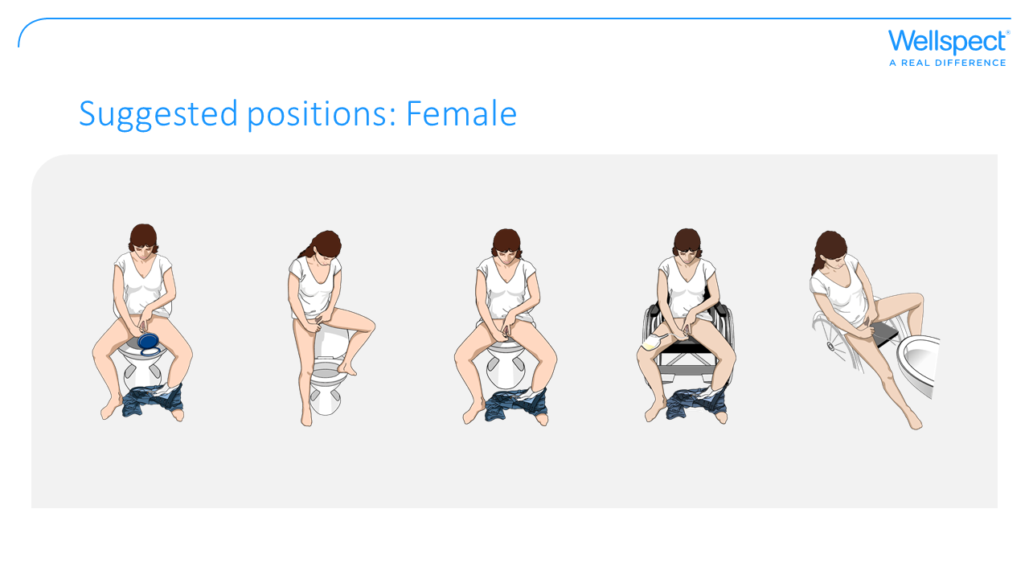

Slide 20
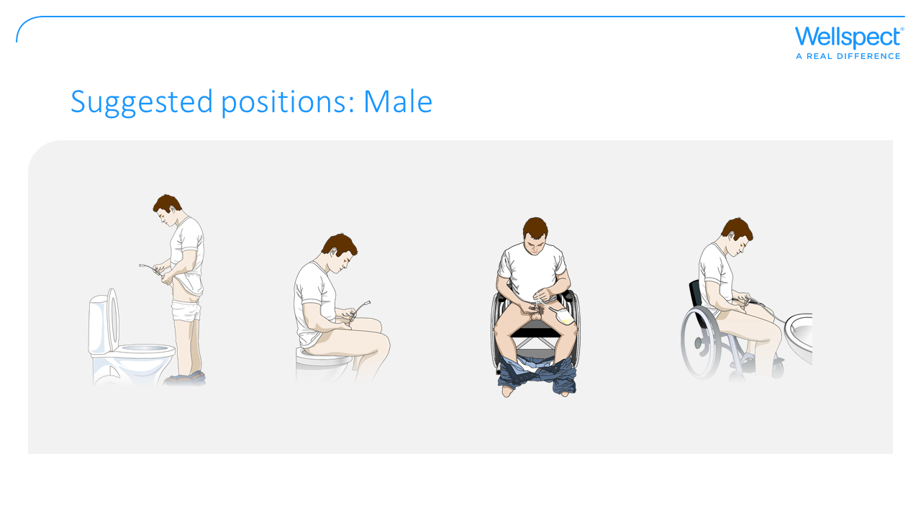

Slide 21
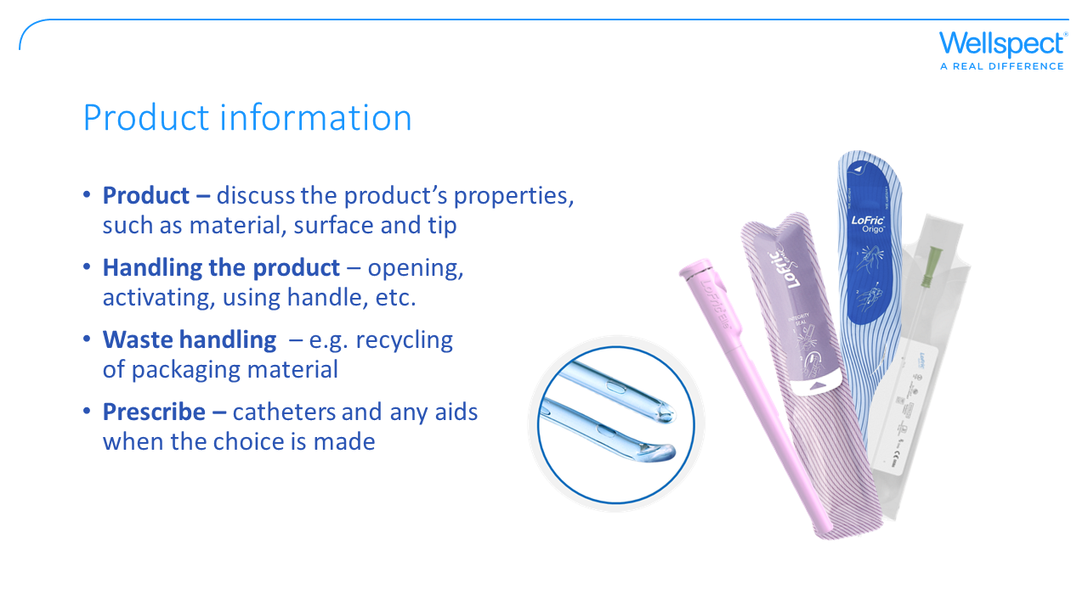
Notes:
A good knowledge of the product is very important. The patient has to be confident about how to handle the product, and that his/her supply of products is taken care of. Choosing a catheter that fits the users’ lifestyle and needs is extremely important in order to ensure best possible compliance.

Slide 22
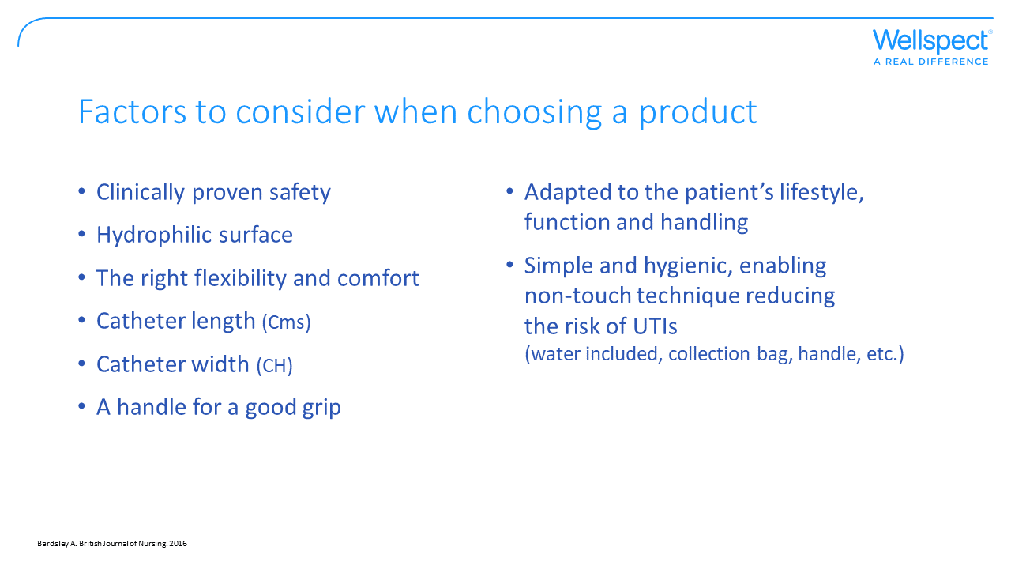
Notes:
Safety proven over time: Are there clinical proof for the catheter that’s supposed to be used for quite some time?
Hydrophilic surface for optimal comfort and reduced risk of urethral trauma during the whole catheterization procedure. Does the catheter have a hydrophilic surface that is preserved during both insertion and withdrawal?
Flexible enough not to damage the urethra and cause bleeding
The proper catheter length is important in order to empty the bladder completely and reducing the risk of infection
The size/girth of the catheter is important too, usually CH 12-14 is used, to ensure a quick and effective emptying of the bladder
A handle providing a good grip and enables non-touch technique
Adaption to the patient’s lifestyle usually means that you use different catheters depending on what situation the patient is in – e.g. at home, travelling, at work, training, etc. The choice of catheter should be adapted to the individual as well as the situation.

Slide 23
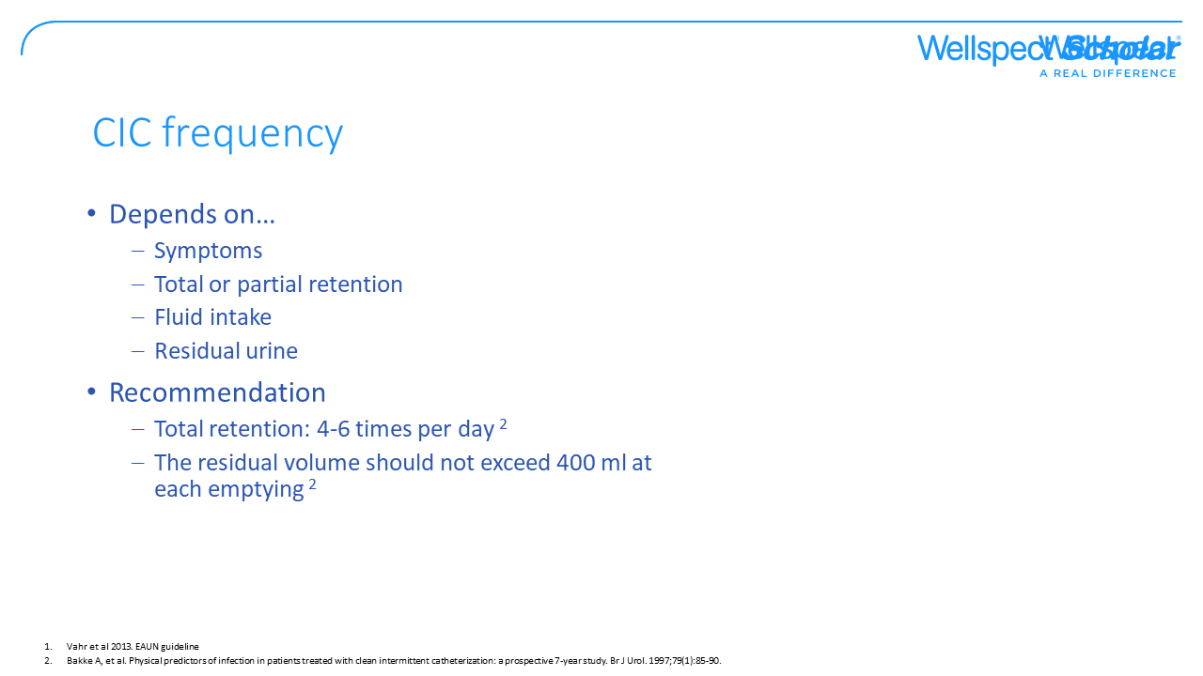
Notes:
Individually customized catheterizations.
A high intravesical pressure reduces blood flow in the mucus of the bladder, increasing the risk of UTIs. Consequently, the amount of urine shouldn't exceed 400 ml at any given time – i.e. both catheterized and naturally expelled amount. The time between catheterization is also important to reduce infection. When you have a total retention, it’s important to achieve a catheterization frequency of 4-6 times/day. Ask the patient to write a micturition chart over their TOTAL urine volume (catheterized & naturally expelled) and bring it to the follow-up. It’s also important that the patient understands the importance of adapting cath frequency to fluid intake – more intake = higher frequency!
If the patient cannot sense the filling of the bladder it’s important to catheterize at regular intervals. Usually CIC is not performed during the night, so keep an eye on the amount of urine in the mornings at the first follow-up. If it’s big it might be a good idea to tell the patient to reduce fluid intake in the evening.

Slide 24
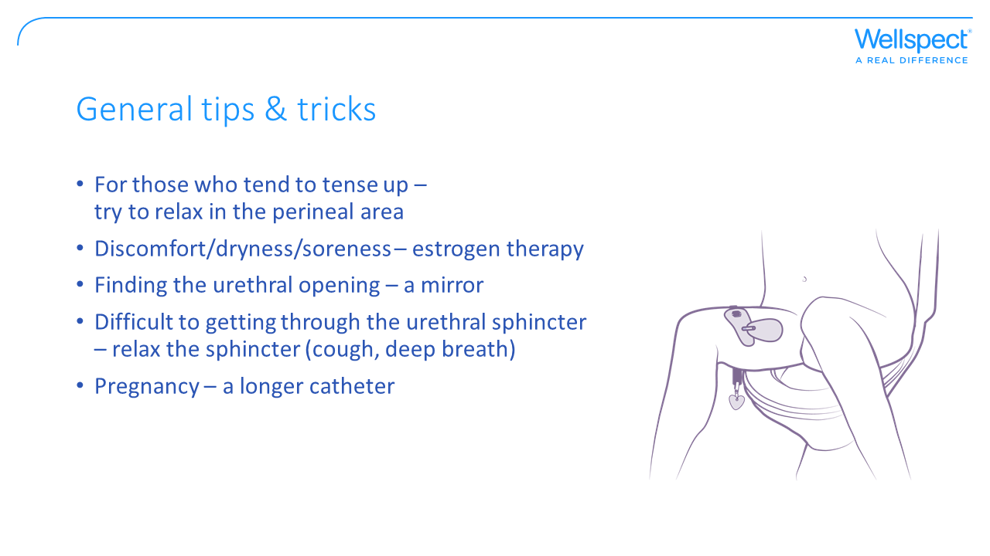
Notes:
Tensing up: Try to find a relaxed and comfortable position when performing CIC
Pain/stinging: In menopause, a lot of women experience dry mucous membranes in the genital area, which can cause pain and irritation. Local estrogen often has a good effect on this. When starting CIC, it’s common to see a little bit of blood on the catheter or in the urine. That’s because the urethra becomes irritated and the mucous membrane isn’t used to the catheter. Using a catheter with a low (or no) osmolality may make this worse by causing pain and bleeding – in that case, switch catheter. Keep in mind that a UTI often causes pain and/or bleeding.
Finding the urethral opening: A mirror and good lightning when starting CIC helps in finding the urethral opening
Difficulty inserting the catheter: Sometimes it can be a hassle getting the catheter past the sphincter (may be caused by detrusor-sphincter dyssynergia). Take a deep breath or coughing might help the sphincter relax.
Pregnancy: The risk of UTIs is increased during pregnancy, in part because of hormonal effects (reduced muscle tonus in the urethral walls, slower passage of urine and increased volume in the bladder), in part through a mechanical impact from uterus on the right ureter. During pregnancy, a longer catheter might be useful on account of changed ”anatomical conditions”.

Slide 25
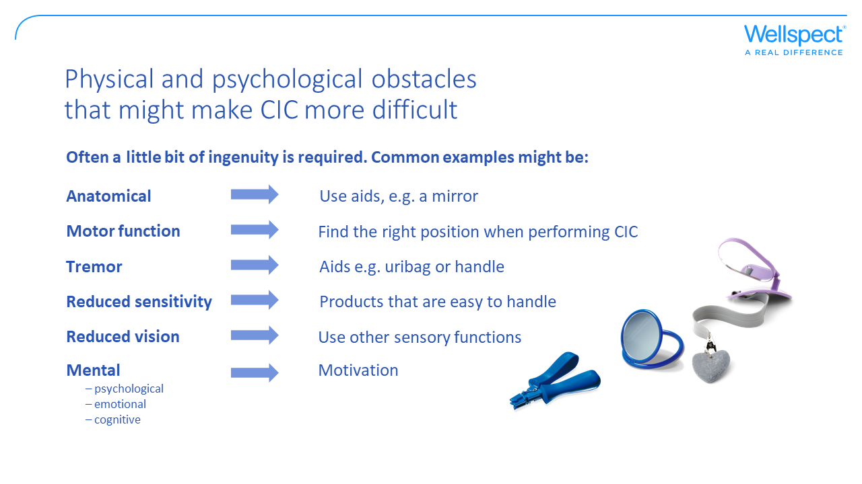
Notes:
Aids such as mirrors, handles etc. can be ordered from Wellspect.

Slide 26
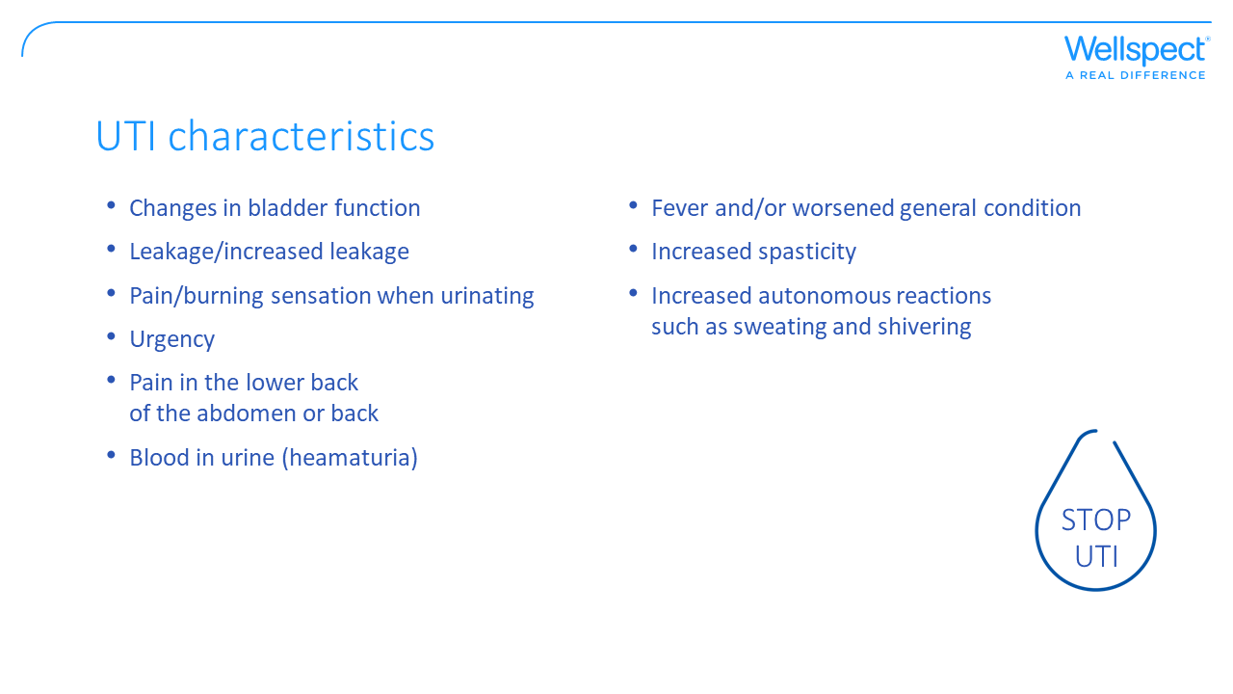
Notes:
Urinary infections is a problem for many catheter users and patients with different conditions impairing their ability to empty their bladder. When bacteria grow and breed, they attach to the mucous membrane of the bladder and make it very difficult/impossible for the immune system to destroy them. When that happens, you have a UTI and the body responds with different symptoms such as fever. A UTI is a bacterial infection affecting any part of the urinary tract. Asymptomatic bacteriuria (ABU) means having bacteria in the urine, but without symptoms from the urinary tract. Having increased number of bacteria in the urine without symptoms does NOT mean that you have a urinary infection. Treating these bacteria with antibiotics might increase the risk later for “meaner” bacteria causing more severe symptoms. Resistance can be developed by taking away bacteria by wrongful use of antibiotics. Be thorough, and always take a urine sample when suspecting a UTI.

Slide 27
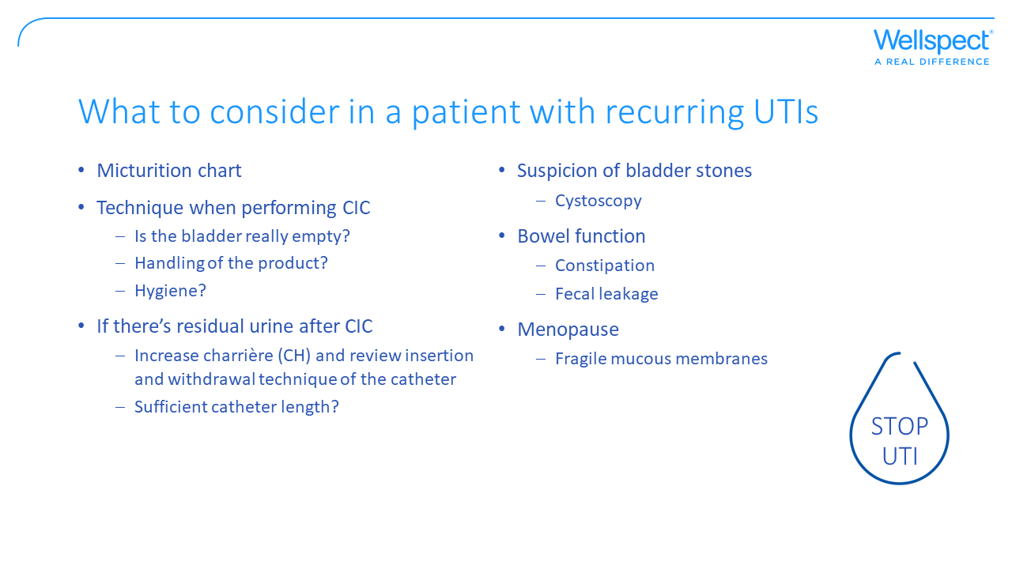
Notes:
Have a look at the micturition chart regarding frequency and volume. Check catheterization technique and what the hand hygiene is like. Choice of catheters and non-touch technique when catheterizing can have a pre-emptive effect. Use an ultrasound to make sure the bladder is empty after CIC. Rule out bladder stones causing the infections – some bacteria are more prone to forming stones, such as Klebsiella and Proteus. Constipation can increase the risk of UTI by complicating bladder emptying since the bowel presses against the bladder. The frail mucous membranes of menopause can also increase the risk of UTIs. Assess the possibility of using local estrogen.

Slide 28
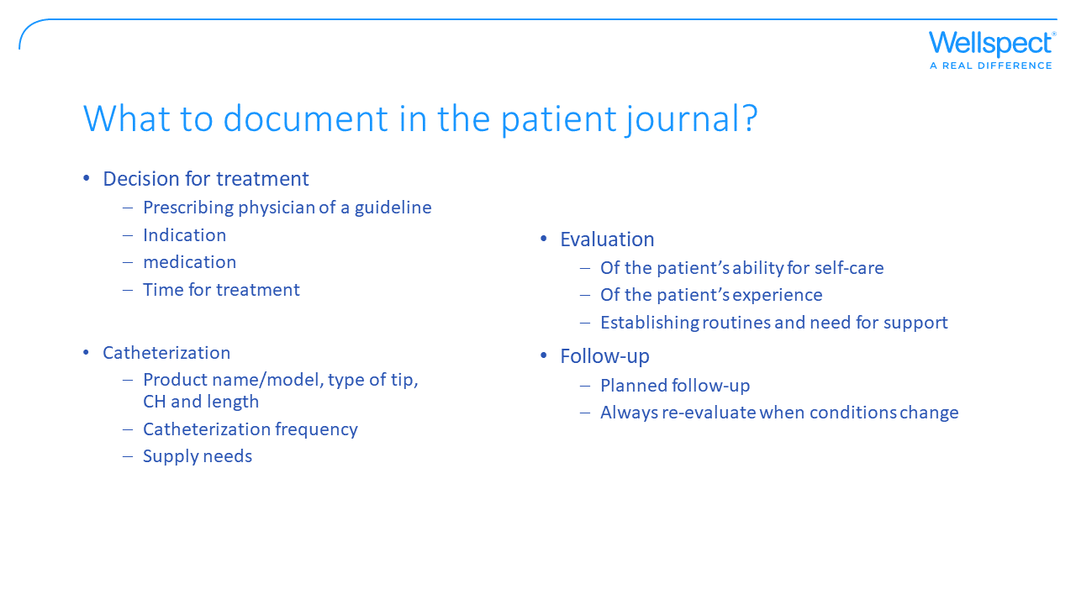
Notes:
Local guidelines for prescribing consumables
In Sweden:
Socialstyrelsen riktlinjer gällande förskrivning av förbrukningsartiklar
Hälso- och sjukvårdslag (2017:30)
Patientsäkerhetslag (2010:659)
Socialstyrelsens föreskrifter (SOSFS 2008:1) om användning av medicintekniska produkter i hälso- och sjukvården
Lag (2002:160) om läkemedelsförmåner m.m.

Slide 29
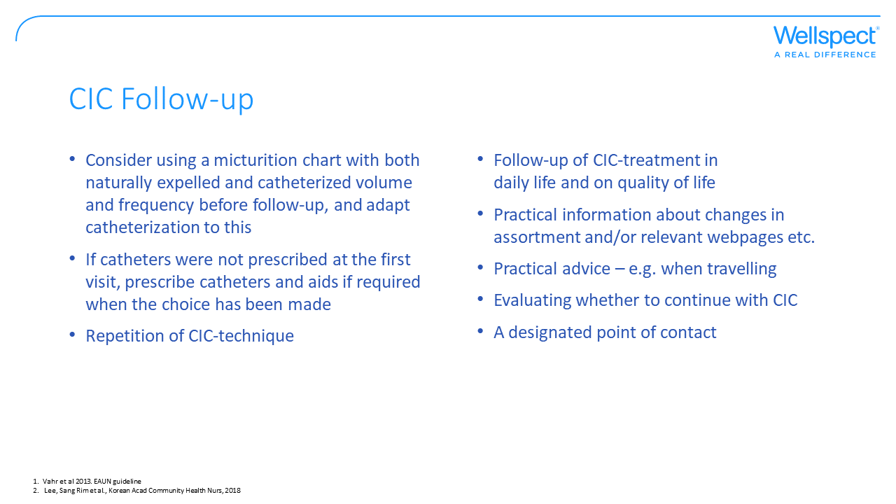
Notes:
Studies emphasize the importance of education, emotional and psychological support, and also regular follow-up in order to optimize compliance over time. When and how to evaluate varies from patient to patient. Integrating CIC in daily life can be difficult, the patient might need continuous support by a contact person. The patient should be offered a follow-up close to the teaching occasion, approx. 2-3 days, in order to ensure the patient understands and carries out CIC without problems. This may be evaluated over the phone or at the reception. The treatment may need change over time, for example residual urine and/or sensibility can change rapidly.

Slide 30
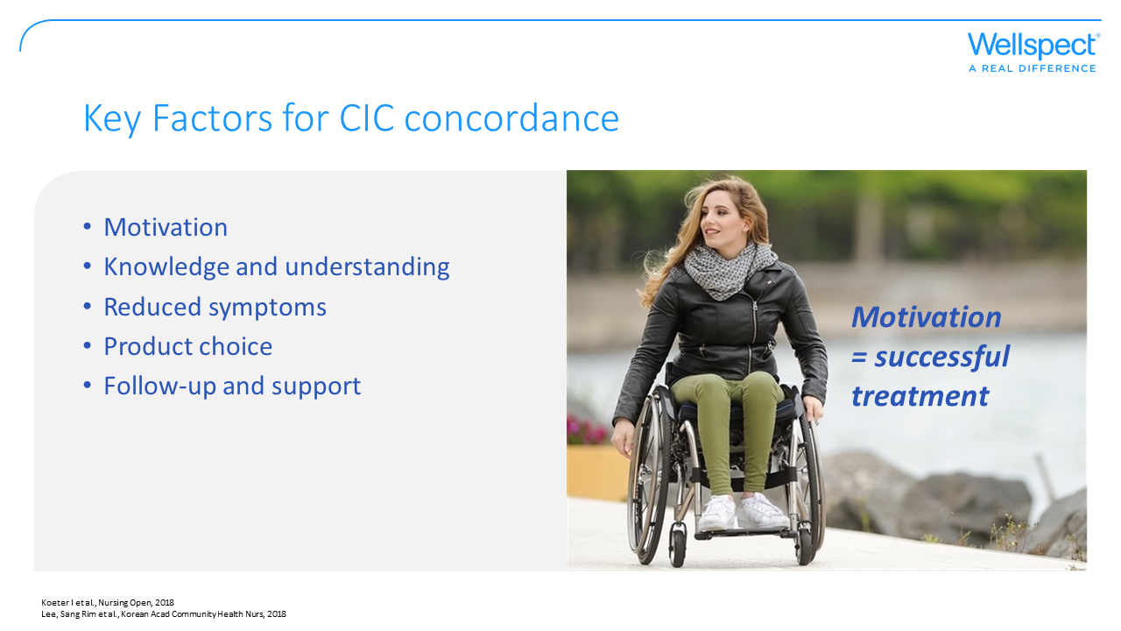
Notes:
Compliance is a key factor for clinical outcome. A patient that feels a part in the decision-making process and can influence his/her treatment, with a therapy that works with life in general, will be more prone to fulfilling the therapy and, hence reaching a good clinical outcome. The CIC-process and product choice should be adapted to the daily life of the user. A decisive factor is whether the products are easy to use and enable easy and effortless catheterization. The choice of catheter should be free: the patients prefer hydrophilic catheters with properties such as comfort, ease of use and infection prevention. Introduction to the therapy and follow up is important: studies show that education, emotional and psychological support and regular follow-up are critical for optimizing compliance over time.

Slide 31
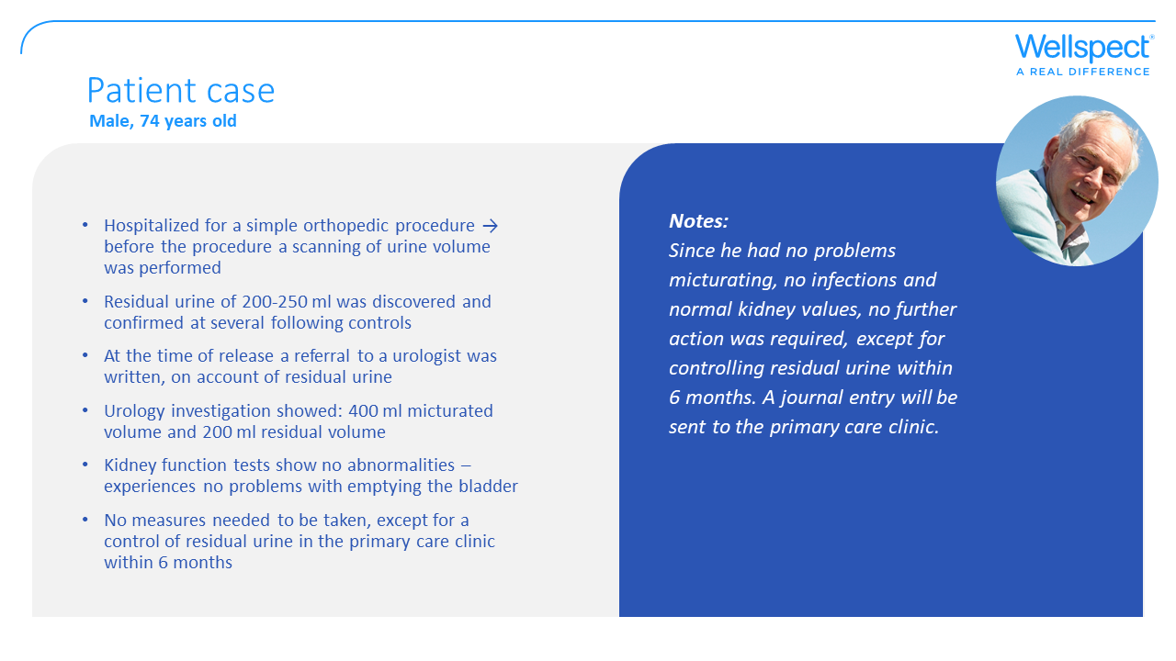

Slide 32
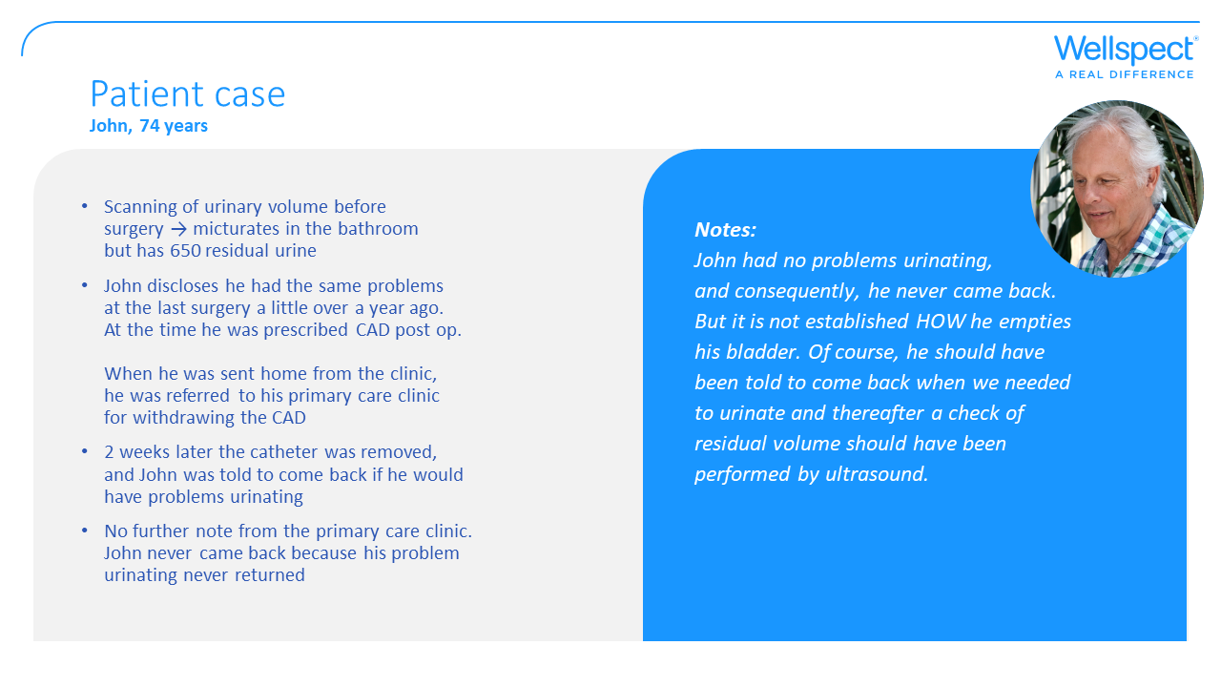

Slide 33
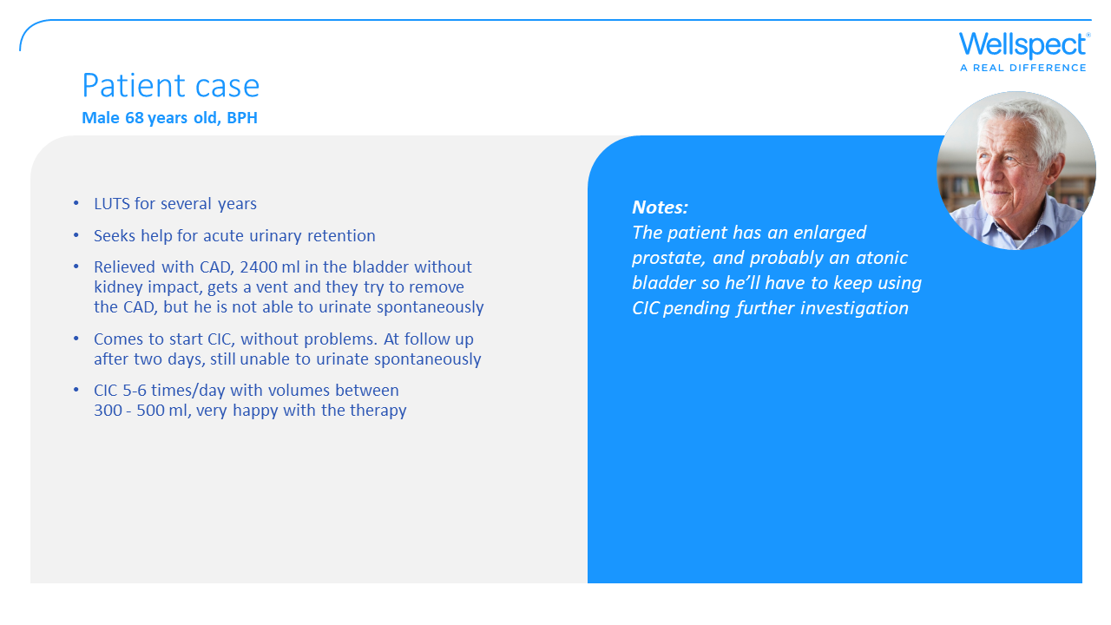

Slide 34
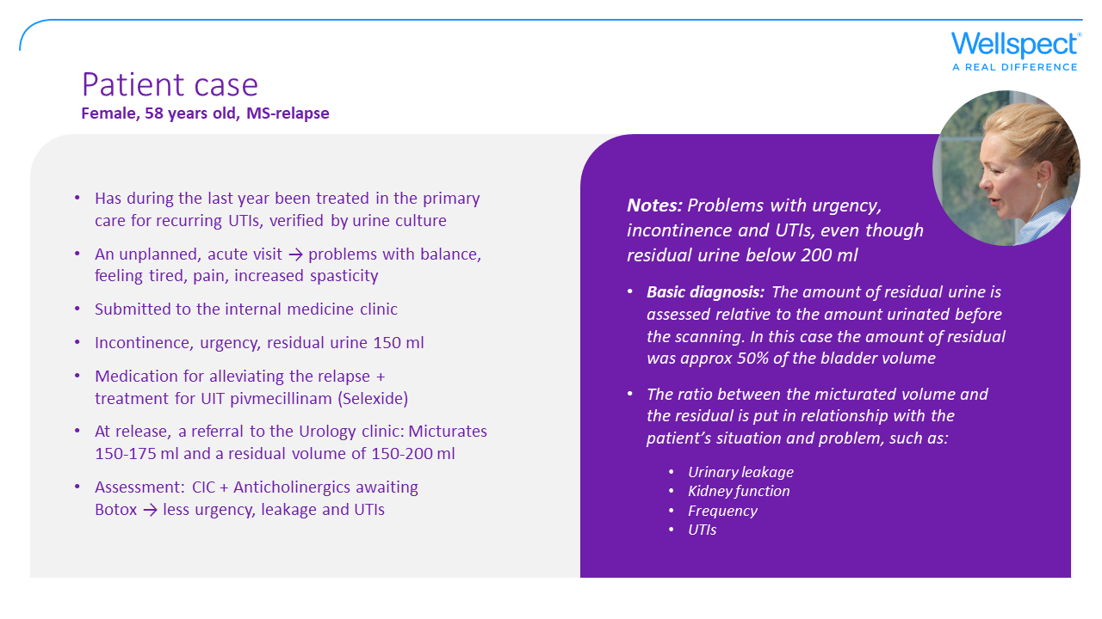

Slide 35


